Slide 1
Fault Detection in Induction Motor using Machine Learning

Slide 2

Induction motor being the workhorse of industry often undergoes certain faults and require maintenance

Slide 3
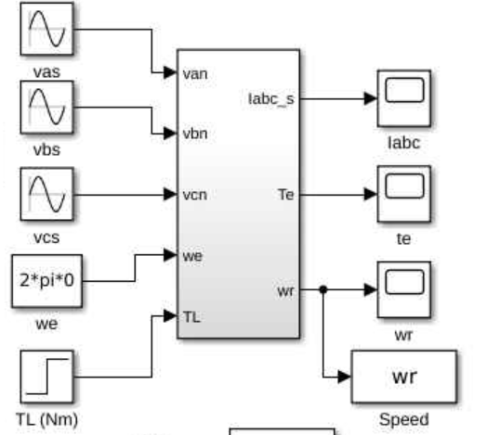
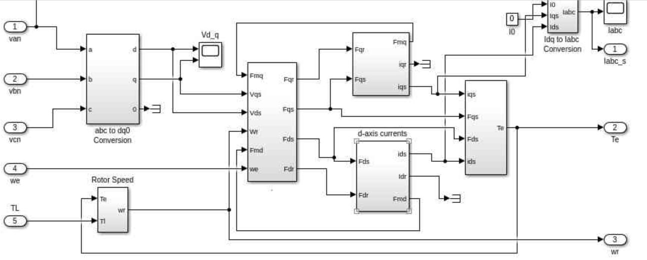
Model of the Induction Motor
MATLAB based mathematical model of the induction motor

Slide 4
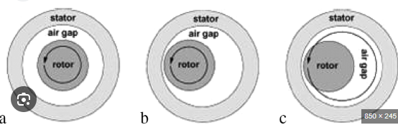
Defects
1. Eccentricity
Imbalance in the rotor's position relative to the stator.
Detectable through changes in current harmonics.

Slide 5
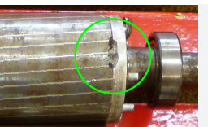
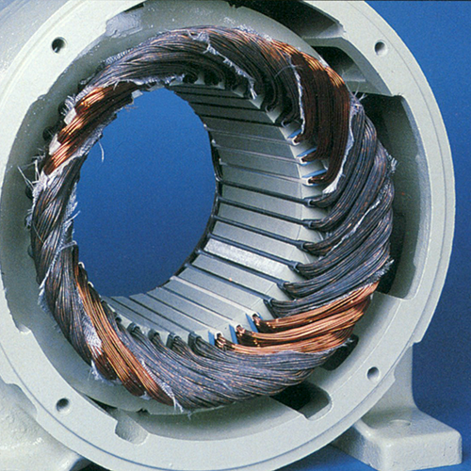
3. Stator Winding Faults:
Includes short circuits or insulation degradation.
Early fault detection is possible by monitoring unbalanced currents or variations in voltage.
2. Broken Rotor Bars:
Leads to asymmetry in the rotor, causing current distortions and torque pulsations.
Easily detectable in the stator current spectrum.

Slide 6
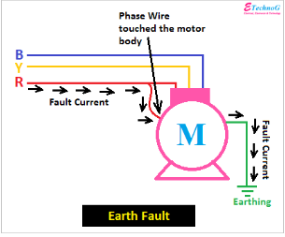
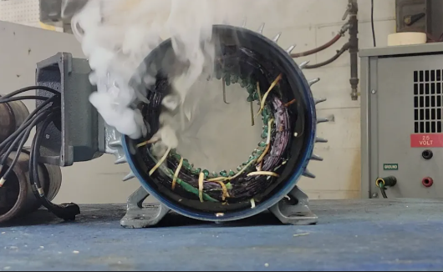
4. Earth Faults:
Leakage of current to the ground, leading to safety risks and inefficiencies.
Visible in current monitoring.
5. Overload:
Excessive current due to overloading, reducing motor life and efficiency.
Detectable through voltage drops and high current readings.
6.Unbalanced Supply Voltage or Current:
Leads to overheating and vibration, affecting motor performance.
Easily monitored using electrical signal analysis.

Slide 7
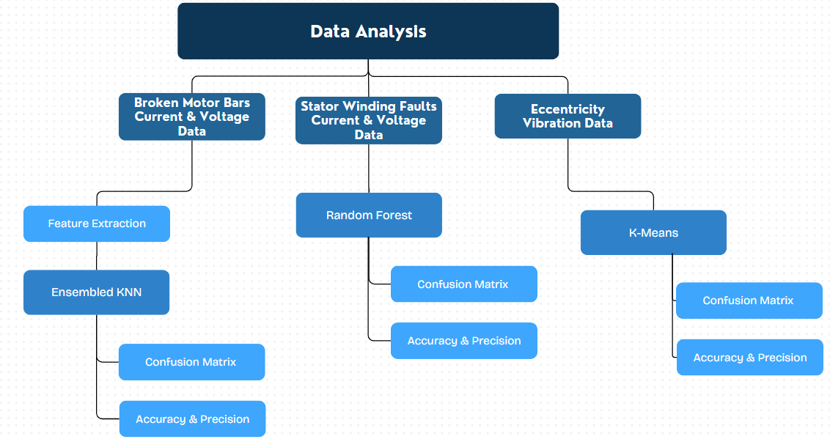
Working Methodology (I)

Slide 8
Working Methodology (II)
Unbalanced Voltage Supply
Input Comparison within range of 5%
Ground fault
Sum of all line currents
Overload
Comparison with rated current

Slide 9
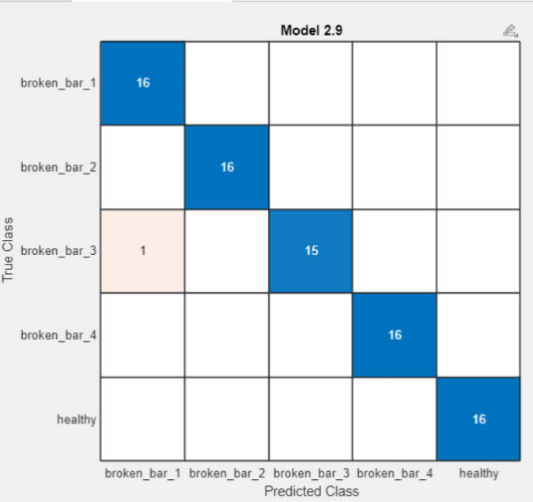
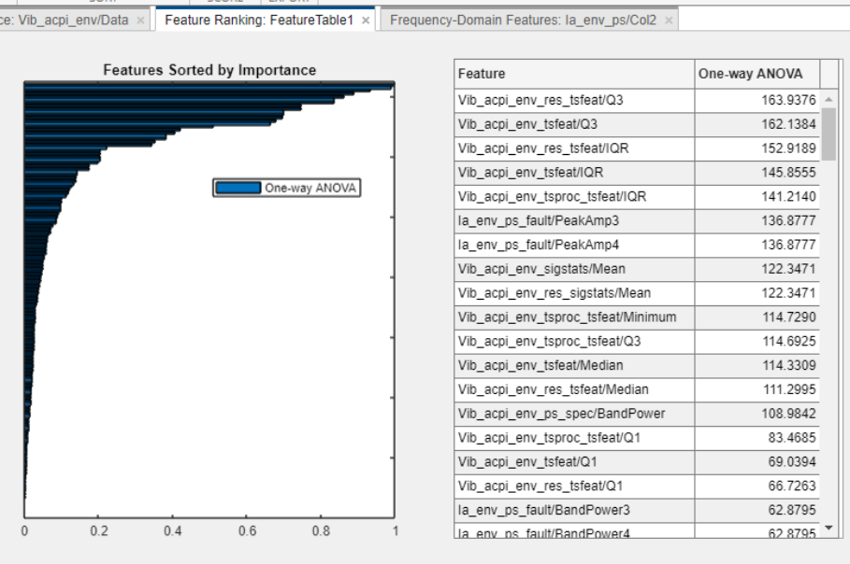
Accuracy & Precision
Dataset: https://ieee-dataport.org/open-access/experimental-database-detecting-and-diagnosing-rotor-broken-bar-three-phase-induction

Slide 10
Current Research
Thermography and Deep Learning: Utilizing thermal imaging with models like InceptionV3 for non-invasive fault detection.
Hybrid Diagnostic Approaches: Combining traditional modeling with machine learning to improve fault detection reliability.
Explainable AI Models: Implementing transparent machine learning models for better understanding of stator fault diagnostics.
IoT-Based Predictive Maintenance: Developing predictive maintenance models using real-time IoT data for proactive fault management.

Slide 11
Conclusion
Successfully identified six major faults in induction motors
Utilized MATLAB for signal processing to analyze fault signatures using time-frequency and spectral analysis.
Implemented machine learning models to classify and predict faults with high accuracy.
Achieved reliable and early fault detection, reducing maintenance costs and downtime in industrial systems.
Demonstrated the effectiveness of integrating signal processing and machine learning for advanced condition monitoring.

Slide 12
THANK YOU

Slide 13
References
https://ieee-dataport.org/open-access/experimental-database-detecting-and-diagnosing-rotor-broken-bar-three-phase-induction
https://www.mathworks.com/matlabcentral/fileexchange/67214-dyanamic-modeling-of-induction-motor-in-simulink?s_tid=FX_rc2_behav
https://www.ijettjournal.org/2015/volume-24/number-5/IJETT-V24P245.pdf
deep learning approach for electric motor fault diagnosis based on modifed InceptionV3 Lifu Xu, Soo SiangTeoh* & Haidi Ibrahim
Fault Detection of Induction Motors with Combined Modelingand Machine-Learning-Based Framework Moritz Benninger 1,* , Marcus Liebschner 1 and Christian Kreischer 2
Predictive Maintenance Model Based on Anomaly Detection in Induction Motors: A Machine Learning Approach Using Real-Time IoT Data Sergio F. Chevtchenko 1 , Monalisa. C. M. dos Santos 1 , Diego. M. Vieira 1 , Ricardo. L. Mota 1 , Elisson Rocha 1 , Bruna. V. Cruz 1 , Danilo Araujo ´ 2 , Ermeson Andrade2

